Slide 1
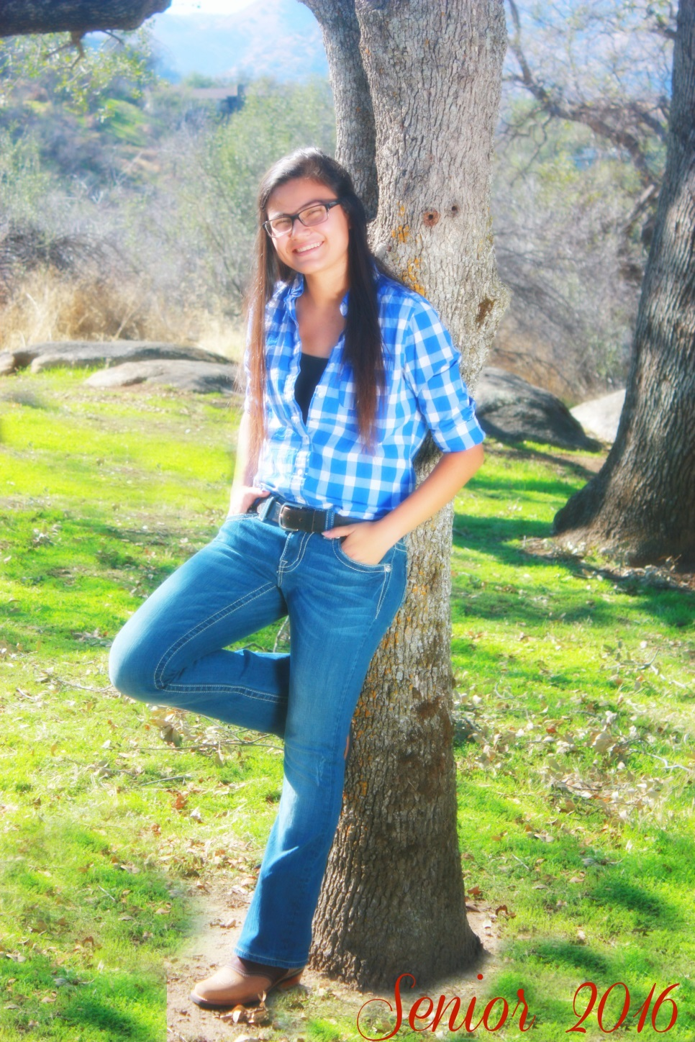
Crystal Lemus
Class of 2016
Lindsay High School

Slide 2
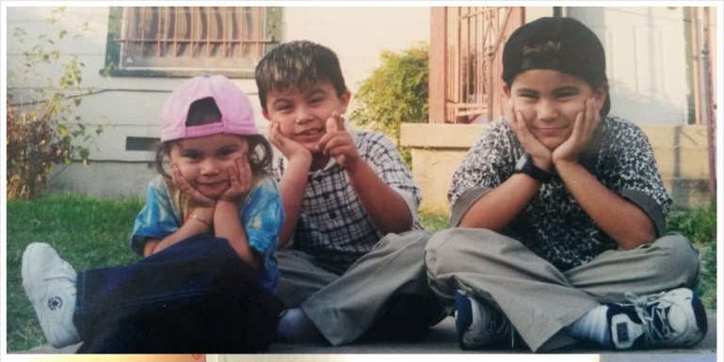
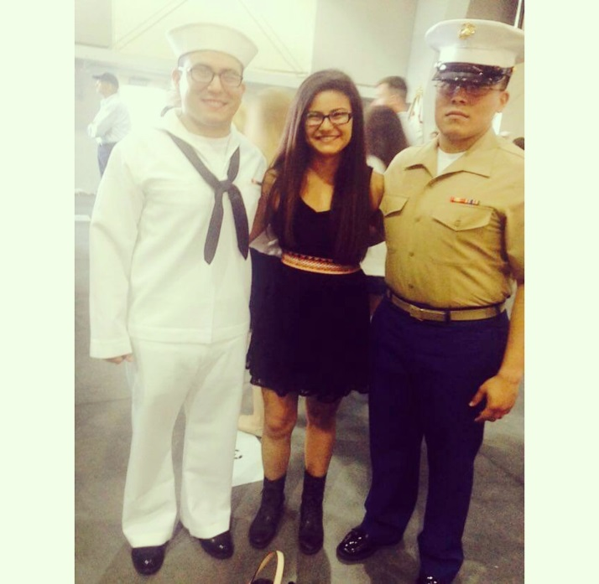
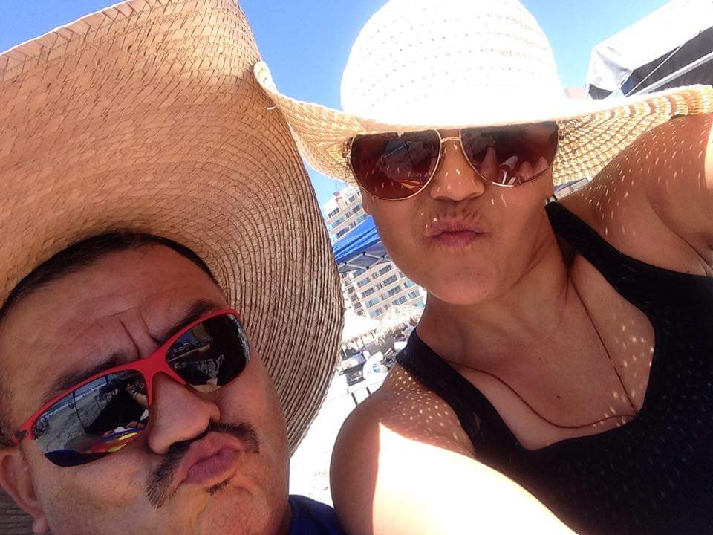
About Me
Born in Visalia
Raised in Texas for 13 years
2 brothers
Role models and motivated
Dyslexic

Slide 3
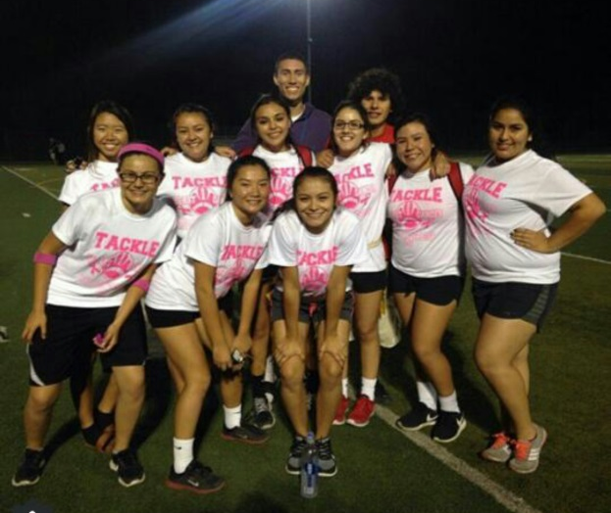
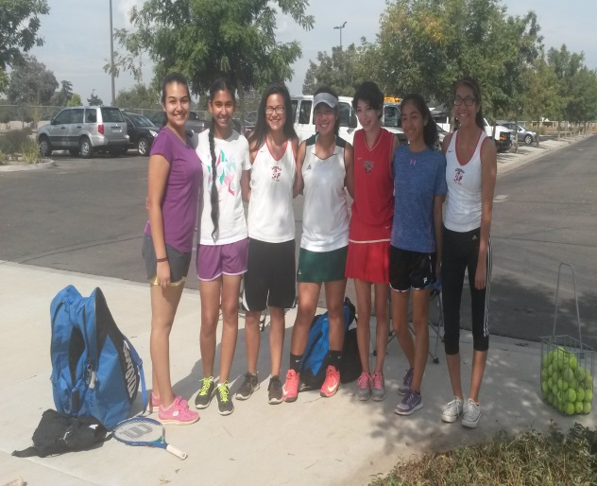
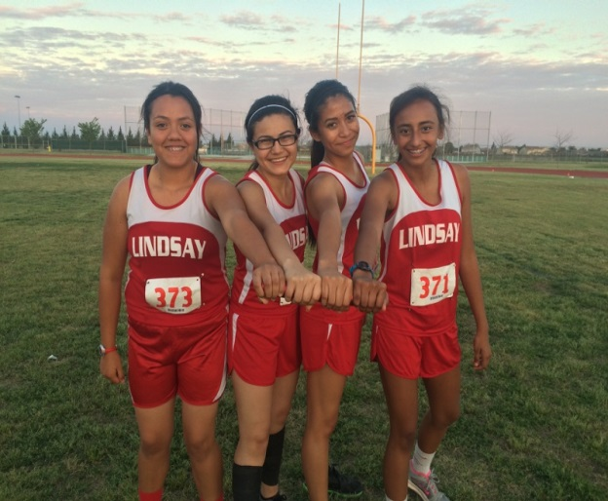
High School Experience
Clubs and Activities
American Sign Language
Future Farmers of America
Future Business Leader of America
Powderpuff
Frosh Scorekeeper for Basketball
Sports
Track and Field
Tennis

Slide 4
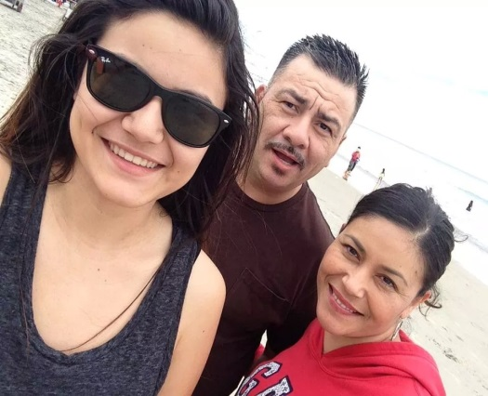
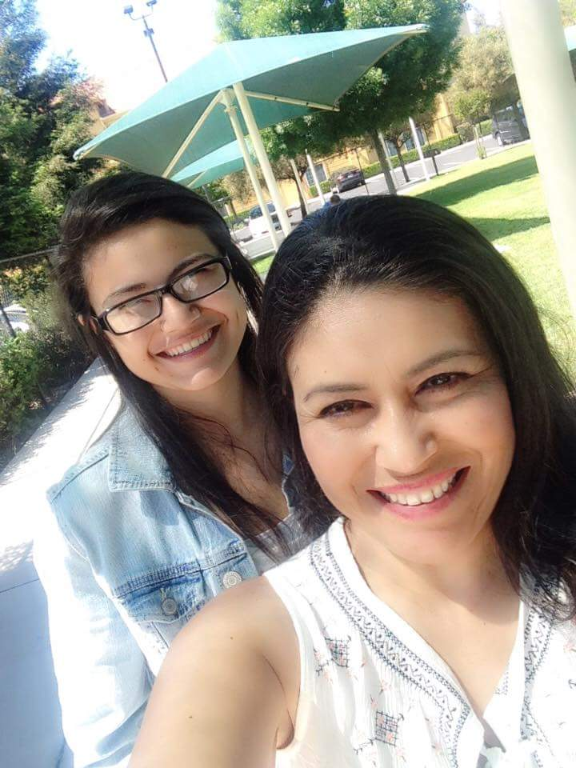
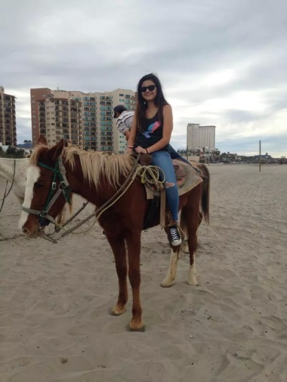
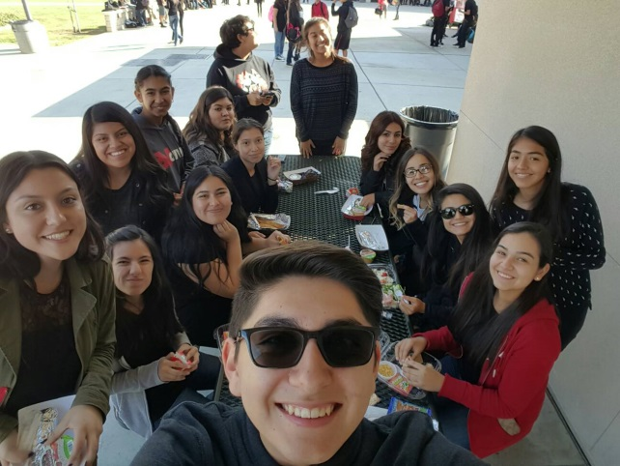
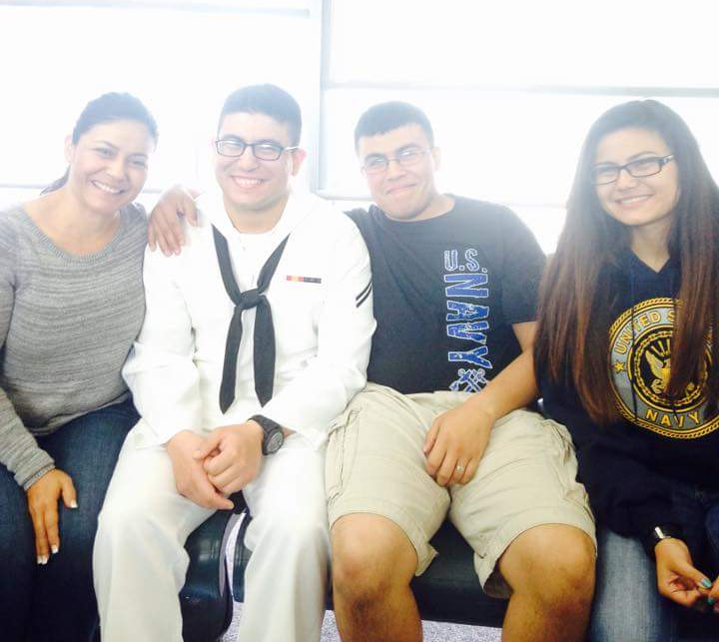
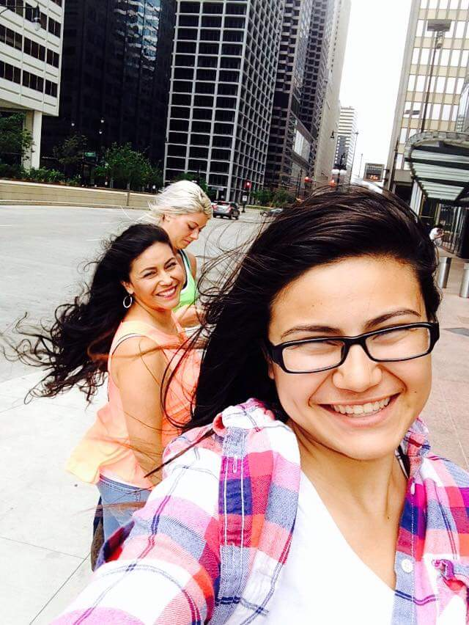
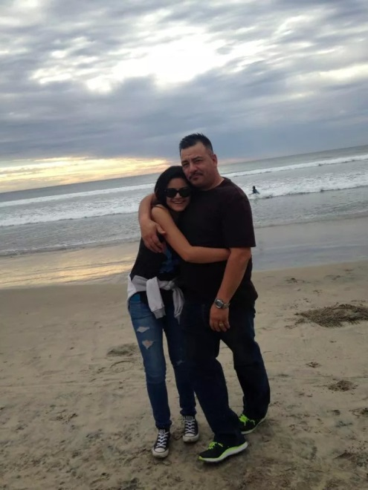
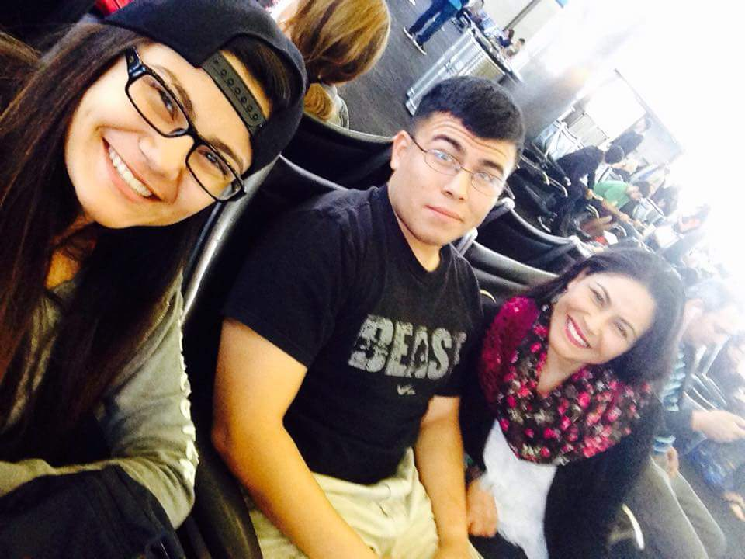

Slide 5
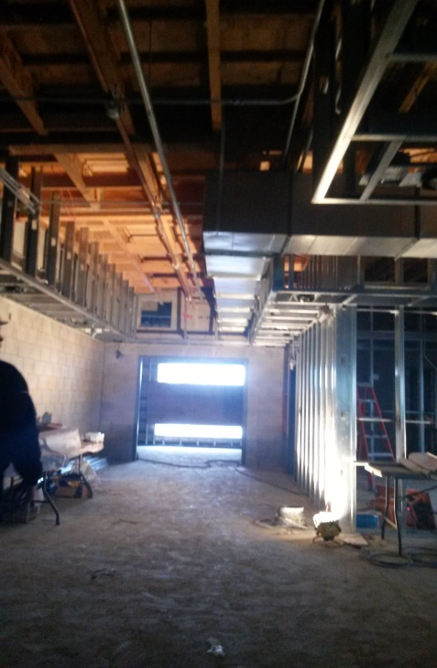
Job Shadow
Mr. Daniel Adam
Construction Management
Traits needed
Leadership
Patience
Sociable

Slide 6
Pathway
Spanish
Took three years
Spanish 1, 2, and 3
Need it in the future
Able to communicate with more people

Slide 7
Struggles During High School
Getting on pace (Procrastination)
Balancing my time
Reading skills
Spanish Class

Slide 8
Post-High School Plans
Major in Psychology, Minor in Architecture
Become a Social worker
Applied to 5 CSUs, 1 Private
Going to Whittier College
Earn a Bachelor's and Masters Degree
Travel the world

Slide 9
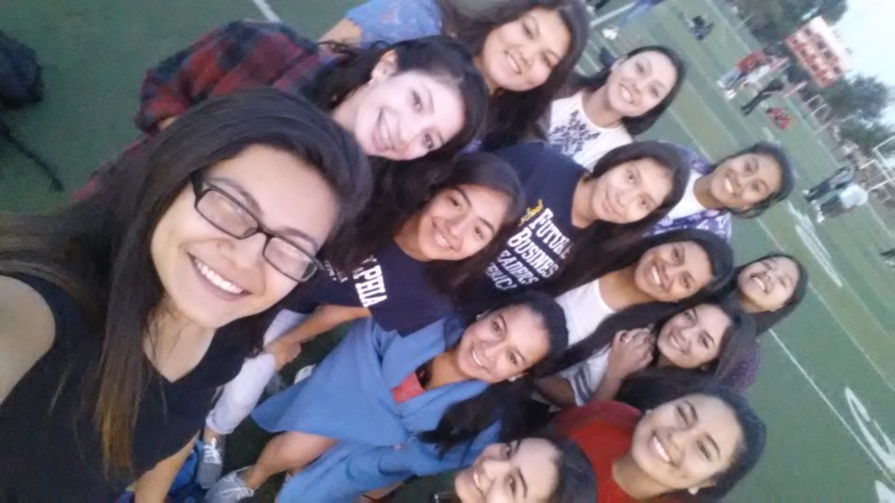
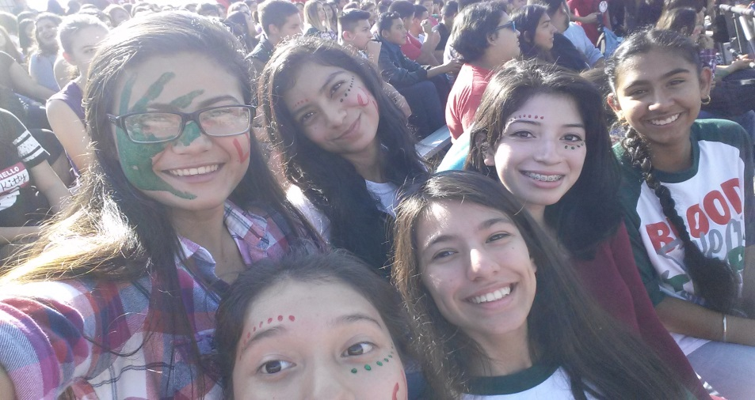
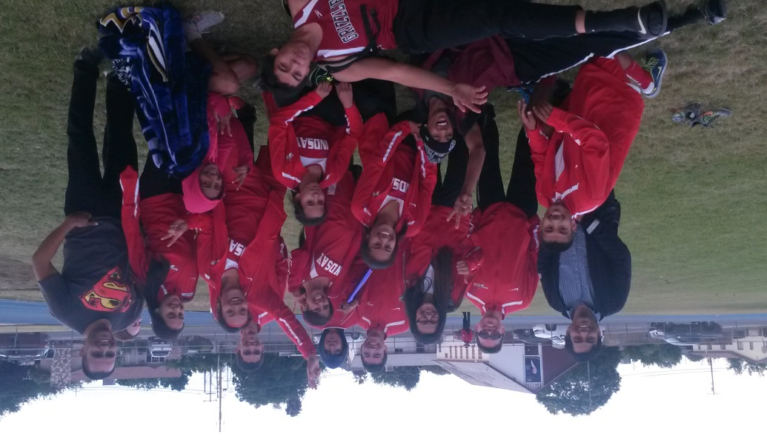
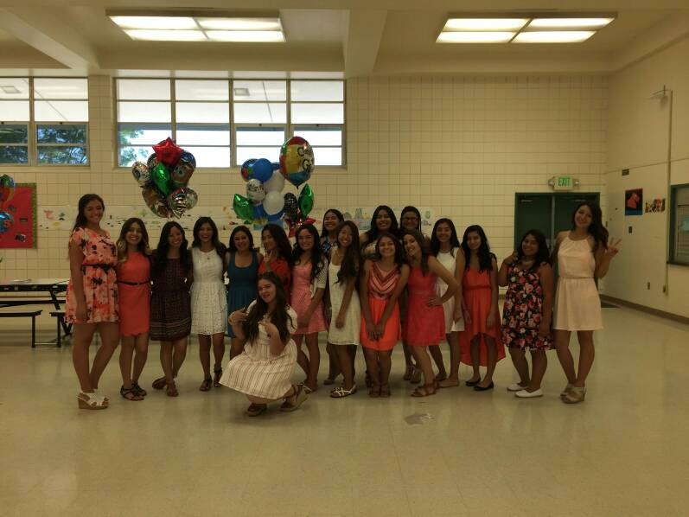
Leaving LHS
Memories
PBS system
Independent

Slide 10
Questions?
Thank you for your time, hope you enjoyed.

